Slide 1
Chapter 4: Boolean Algebra and Logic Simplification

Slide 2
Chapter Objectives
After studying this chapter, students should be able to:
Apply the laws, rules, and DeMorgan’s theorems to simplify and evaluate Boolean expressions.
Convert Boolean expressions into SOP (sum-of-products) and POS (product-of-sums) forms.
Use truth tables and Karnaugh maps (including "don't care" conditions) to analyze and minimize logic functions.
Apply the Quine-McCluskey method for logic simplification.
Write basic VHDL programs to implement simple Boolean logic.

Slide 3
Chapter Outline
4.1 Boolean Operations and Expressions
4.2 Laws and Rules of Boolean Algebra 4.3 DeMorgan’s Theorems 4.4 Boolean Analysis of Logic Circuits 4.5 Logic Simplification Using Boolean Algebra 4.6 Standard Forms of Boolean Expressions 4.7 Boolean Expressions and Truth Tables 4.8 The Karnaugh Map 4.9 Karnaugh Map SOP Minimization 4.10 Karnaugh Map POS Minimization 4.11 The Quine-McCluskey Method 4.12 Boolean Expressions with VHDL
Multiple-choice test and Problems

Slide 4
4.1. Boolean Operations and Expressions
Boolean algebra is the mathematics of digital logic. A basic knowledge of Boolean algebra is indispensable to the study and analysis of logic circuits. In the last chapter, Boolean operations and expressions in terms of their relationship to NOT, AND, OR, NAND, and NOR gates were introduced. Variable, complement, and literal are terms used in Boolean algebra. A variable is a symbol (usually an italic uppercase letter or word) used to represent an action, a condition, or data. Any single variable can have only a 1 or a 0 value.

Slide 5


4.1. Boolean Operations and Expressions
Boolean Addition: The OR operation is the Boolean equivalent of addition.
Boolean Multiplication: The AND operation is the Boolean equivalent of multiplication.

Slide 6

4.2. Laws and Rules of Boolean Algebra
Laws and Rules of Boolean Algebra As in other areas of mathematics, certain well-developed rules and laws must be followed in order to properly apply Boolean algebra. The most important of these are presented in this section. Laws of Boolean Algebra: The basic laws of Boolean algebra—the commutative laws for addition and multiplication, the associative laws for addition and multiplication, and the distributive law—are the same as in ordinary algebra. Each of the laws is illustrated with two or three variables, but the number of variables is not limited to this. Commutative Laws The commutative law of addition for two variables is written as

Slide 7
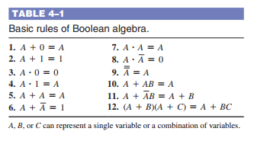
4.2. Laws and Rules of Boolean Algebra
Rules of Boolean Algebra

Slide 8


4.3. DeMorgan’s Theorems
DeMorgan, a mathematician who knew Boole, proposed two theorems that are an important part of Boolean algebra. In practical terms, DeMorgan’s theorems provide mathematical verification of the equivalency of the NAND and negative-OR gates and the equivalency of the NOR and negative-AND gates The complement of two or more ANDed variables is equivalent to the OR of the complements of the individual variables. The formula for expressing this theorem for two variables is
The complement of two or more ORed variables is equivalent to the AND of the complements of the individual variables. The formula for expressing this theorem for two variables is

Slide 9
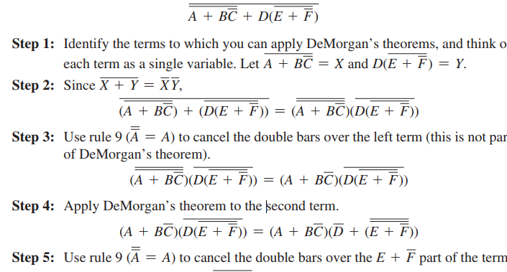
4.3. DeMorgan’s Theorems
Applying DeMorgan’s Theorems The following procedure illustrates the application of DeMorgan’s theorems and Boolean algebra to the specific expression

Slide 10
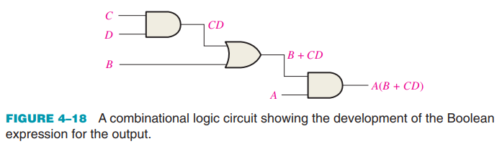
4.4. Boolean Analysis of Logic Circuits
Boolean algebra provides a concise way to express the operation of a logic circuit formed by a combination of logic gates so that the output can be determined for various combinations of input values. Boolean Expression for a Logic Circuit: A combinational logic circuit can be described by a Boolean equation.

Slide 11
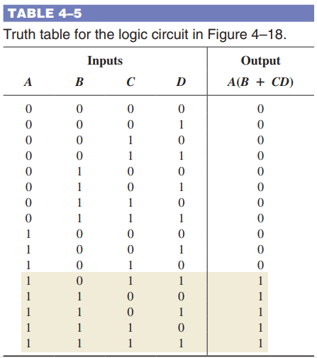
4.4. Boolean Analysis of Logic Circuits
Constructing a Truth Table for a Logic Circuit: A combinational logic circuit can be described by a truth table.

Slide 12
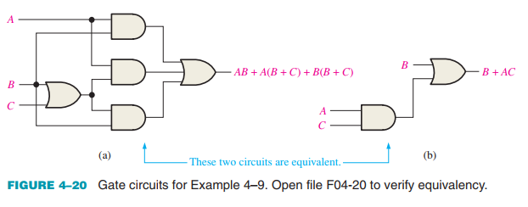
4.5. Logic Simplification Using Boolean Algebra
A logic expression can be reduced to its simplest form or changed to a more convenient form to implement the expression most efficiently using Boolean algebra.

Slide 13

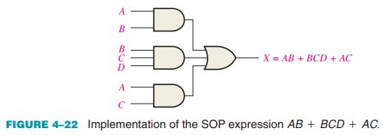
4.6. Standard Forms of Boolean Expressions
All Boolean expressions, regardless of their form, can be converted into either of two standard forms: the sum-of-products form or the product-of-sums form. Standardization makes the evaluation, simplification, and implementation of Boolean expressions much more systematic and easier. The Sum-of-Products (SOP) Form: An SOP expression can be implemented with one OR gate and two or more AND gates
AND/OR Implementation of an SOP Expression

Slide 14
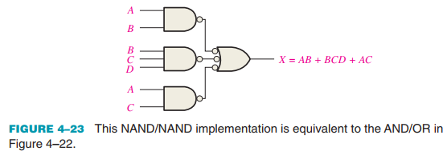
4.6. Standard Forms of Boolean Expressions
All Boolean expressions, regardless of their form, can be converted into either of two standard forms: the sum-of-products form or the product-of-sums form. Standardization makes the evaluation, simplification, and implementation of Boolean expressions much more systematic and easier. The Sum-of-Products (SOP) Form: An SOP expression can be implemented with one OR gate and two or more AND gates
NAND/NAND Implementation of an SOP Expression

Slide 15

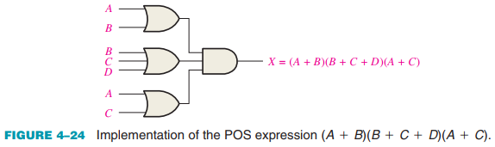
4.6. Standard Forms of Boolean Expressions
The Product-of-Sums (POS) Form: When two or more sum terms are multiplied the resulting expression is a product-of-sums (POS)
Implementation of a POS Expression.

Slide 16
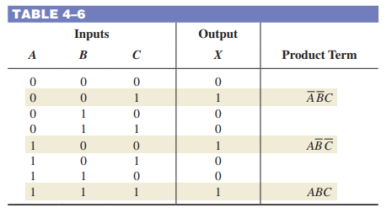
4.7. Boolean Expressions and Truth Tables
All standard Boolean expressions can be easily converted into truth table format using binary values for each term in the expression. The truth table is a common way of presenting, in a concise format, the logical operation of a circuit. Also, standard SOP or POS expressions can be determined from a truth table. Converting SOP Expressions to Truth Table Format

Slide 17
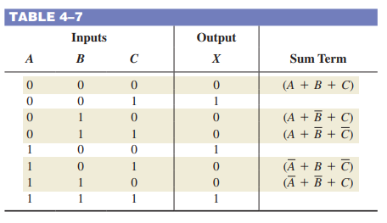
4.7. Boolean Expressions and Truth Tables
All standard Boolean expressions can be easily converted into truth table format using binary values for each term in the expression. The truth table is a common way of presenting, in a concise format, the logical operation of a circuit. Also, standard SOP or POS expressions can be determined from a truth table. Converting POS Expressions to Truth Table Format

Slide 18
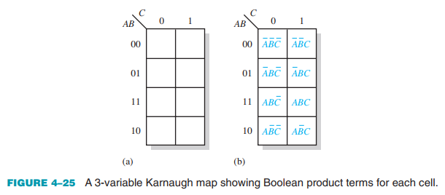
4.8. The Karnaugh Map
A Karnaugh map provides a systematic method for simplifying Boolean expressions and, if properly used, will produce the simplest SOP or POS expression possible, known as the minimum expression. The purpose of a Karnaugh map is to simplify a Boolean expression. The 3-Variable Karnaugh Map

Slide 19
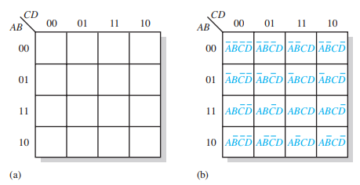

4.8. The Karnaugh Map
A Karnaugh map provides a systematic method for simplifying Boolean expressions and, if properly used, will produce the simplest SOP or POS expression possible, known as the minimum expression. The purpose of a Karnaugh map is to simplify a Boolean expression. The 4-Variable Karnaugh Map

Slide 20
4.8. The Karnaugh Map
The Quine-McCluskey Method - Minimizing Boolean functions using Karnaugh maps is practical only for up to four or five variables. Also, the Karnaugh map method does not lend itself to be automated in the form of a computer program. - The Quine-McCluskey method is more practical for logic simplification of functions with more than four or five variables. It also has the advantage of being easily implemented with a computer or programmable calculator. - The Quine-McCluskey method is functionally similar to Karnaugh mapping, but the tabular form makes it more efficient for use in computer algorithms, and it also gives a way to check that the minimal form of a Boolean function has been reached. This method is sometimes referred to as the tabulation method.

Slide 21
4.8. The Karnaugh Map
Espresso Algorithm
- Although the Quine-McCluskey method is well suited to be implemented in a computer program and can handle more variables than the Karnaugh map method, the result is still far from efficient in terms of processing time and memory usage. Adding a variable to the function will roughly double both of these parameters because the truth table length increases exponentially with the number of variables. Functions with a large number of variables have to be minimized with other methods such as the Espresso logic minimizer, which has become the de facto world standard. Compared to the other methods, Espresso is essentially more efficient in terms of reducing memory usage and computation time by several orders of magnitude.
- There are essentially no restrictions to the number of variables, output functions, and product terms of a combinational logic function. In general, tens of variables with tens of output functions can be handled by Espresso. The Espresso algorithm has been incorporated as a standard logic function minimization step in most logic synthesis tools for programmable logic devices.

Slide 22
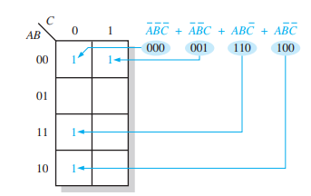
4.9. Karnaugh Map SOP Minimization
A minimized SOP expression contains the fewest possible terms with the fewest possible variables per term. Generally, a minimum SOP expression can be implemented with fewer logic gates than a standard expression. Mapping a Standard SOP Expression

Slide 23
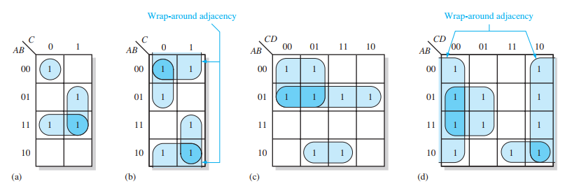
4.9. Karnaugh Map SOP Minimization
A minimized SOP expression contains the fewest possible terms with the fewest possible variables per term. Generally, a minimum SOP expression can be implemented with fewer logic gates than a standard expression. Karnaugh Map Simplification of SOP Expressions

Slide 24
4.9. Karnaugh Map SOP Minimization
A minimized SOP expression contains the fewest possible terms with the fewest possible variables per term. Generally, a minimum SOP expression can be implemented with fewer logic gates than a standard expression. Determining the Minimum SOP Expression from the Map - When all the 1s representing the standard product terms in an expression are properly mapped and grouped, the process of determining the resulting minimum SOP expression begins. - Group the cells that have 1s. Each group of cells containing 1s creates one product term composed of all variables that occur in only one form (either uncomplemented or complemented) within the group. Variables that occur both uncomplemented and complemented within the group are eliminated. These are called contradictory variables.

Slide 25
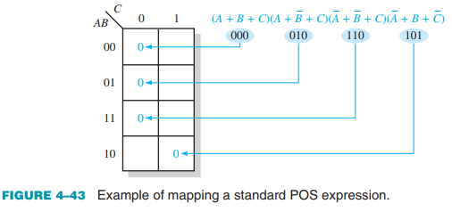
4.10. Karnaugh Map POS Minimization
Mapping a Standard POS Expression For a POS expression in standard form, a 0 is placed on the Karnaugh map for each sum term in the expression. Each 0 is placed in a cell corresponding to the value of a sum term. Step 1: Determine the binary value of each sum term in the standard POS expression. This is the binary value that makes the term equal to 0. Step 2: As each sum term is evaluated, place a 0 on the Karnaugh map in the corresponding cell

Slide 26
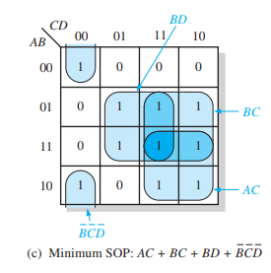
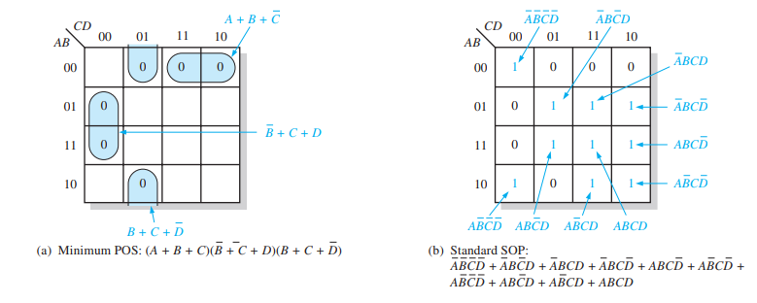
4.10. Karnaugh Map POS Minimization
Converting Between POS and SOP Using the Karnaugh Map When a POS expression is mapped, it can easily be converted to the equivalent SOP form directly from the Karnaugh map. Also, given a mapped SOP expression, an equivalent POS expression can be derived directly from the map.

Slide 27
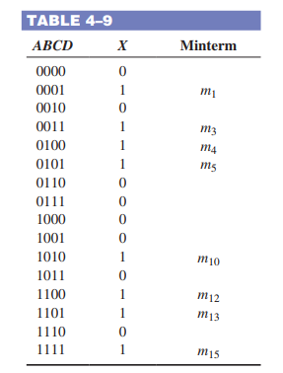
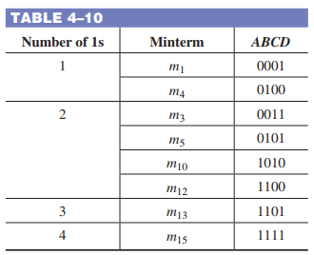
4.11. The Quine-McCluskey Method
For Boolean functions up to four variables, the Karnaugh map method is a powerful minimization method. When there are five variables, the Karnaugh map method is difficult to apply and completely impractical beyond five. To illustrate, we will use the expression:
Bước 1
Bước 2

Slide 28
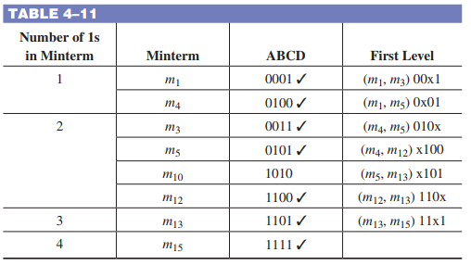
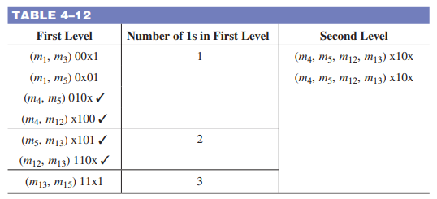

4.11. The Quine-McCluskey Method
For Boolean functions up to four variables, the Karnaugh map method is a powerful minimization method. When there are five variables, the Karnaugh map method is difficult to apply and completely impractical beyond five. To illustrate, we will use the expression:
Bước 3
Bước 4

Slide 29
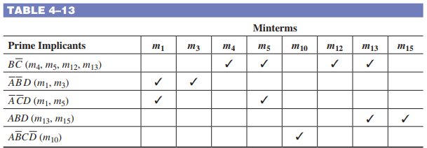
4.11. The Quine-McCluskey Method
For Boolean functions up to four variables, the Karnaugh map method is a powerful minimization method. When there are five variables, the Karnaugh map method is difficult to apply and completely impractical beyond five. To illustrate, we will use the expression:
Bước 5

Slide 30
4.12. Boolean Expressions with VHDL
The ability to create simple and compact code is important in a VHDL program. By simplifying a Boolean expression for a given logic function, it is easier to write and debug the VHDL code; in addition, the result is a clearer and more concise program. Boolean Algebra in VHDL Programming The basic rules of Boolean algebra that you have learned in this chapter should be applied to any applicable VHDL code. Eliminating unnecessary gate logic allows you to create compact code that is easier to understand, especially when someone has to go back later and update or modify the program. In Example 4–37, Page 140, Text book “Digital Fundamentals”

Slide 31
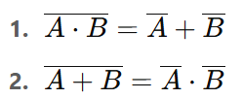
SUMMARY
Chapter 4: Boolean Algebra and Logic Simplification
Gate symbols and Boolean expressions illustrate basic logic operations:
NOT
Fundamental Boolean laws and rules include commutative, associative, distributive laws, and identities like
DeMorgan’s Theorems state that:
Karnaugh maps are tools used to simplify Boolean expressions; 3-variable maps have 8 cells, and 4-variable maps have 16.
Quine-McCluskey is another method for Boolean simplification, and VHDL supports three abstraction levels: data flow, structural, and behavioral.

Slide 32
MULTIPLE-CHOICE TEST AND PROBLEMS
Complete the true/false questions, multiple-choice questions, and end-of-chapter exercises in the primary textbook.

